Slide 1
BIBFLOW Project Update
Xiaoli Li
Co-head of Content Support Services
University of California Davis Library
PCC Operations Committee Meeting
May 5, 2016

Slide 2
Overview of BIBFLOW Project
Is a 2-year project of the UC Davis University Library and Zepheira, funded by Institute of Museum and Library Sciences (May 2014 – April 2016)
Its official title is “Reinventing Cataloging: Models for the Future of Library Operations”
Is a research project that will address questions like “What impact will adoption of BIBFRAME on technical services workflows in an academic library”?
Its primary purpose is to understand ecosystem, test solutions, and provide a roadmap of how libraries can iteratively migrate to linked data without disrupting patron or business services.

Slide 3
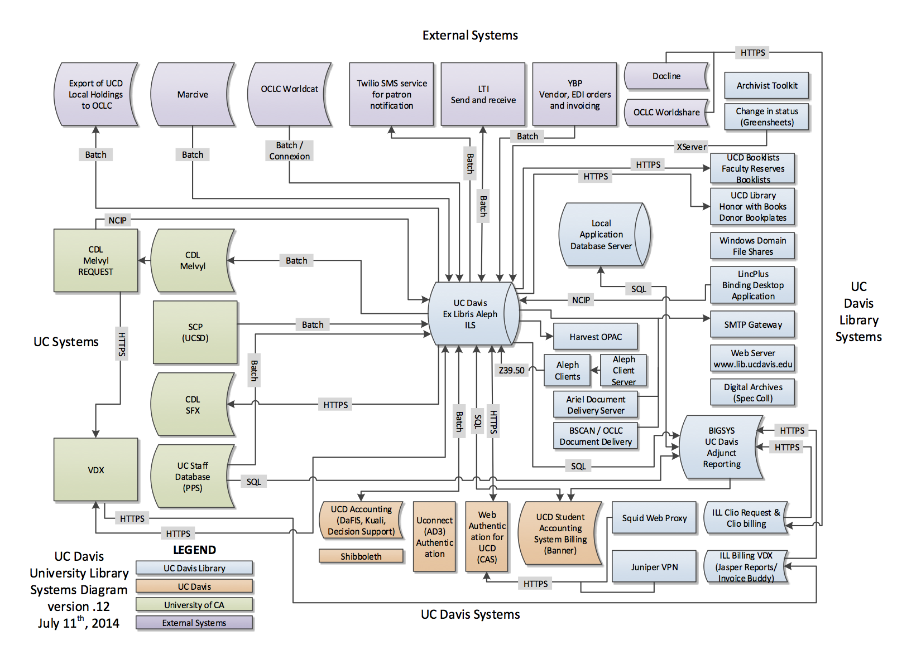

Slide 4
Triplestore
Human Discovery
Machine Discovery
Vendors
ILs
LD Catalog Interface
Roadmap: Primary Stakeholders

Slide 5
Pull Authority Data
Discovery
Interface
Exchange
Circulation
Data
Push User Contributions
SPARQL
Endpoint
Pull Graphs
Triplestore
Respond to
Machine Queries
Push Triples
Push Triples
Push Thin MARC
Pull Schema
OCLC
Pull Triples
ILS
BIBFLOW:SCRIBE
LD Cataloging
DB
Pull Authorities
Catalogue / Ingest
URI Based Marc
Authorities
MARC
URI
Pull
Push
Native Operation or Ingest
Script / Tool (All other transactions are via API / Endpoint)

Slide 6
Discovery Information Flow

Slide 7
Discovery
Interface
User Submits Search Request
SPARQL
Endpoint
Triplestore
OCLC
ILS
BIBFLOW:SCRIBE
LD Cataloging
DB
Authorities
MARCURI
Step 1: User Submits Search Query

Slide 8
Discovery
Interface
SPARQL
Endpoint
Search Results Returned (Thin local Graph)
Triplestore
OCLC
ILS
BIBFLOW:SCRIBE
LD Cataloging
DB
Authorities
MARC
URI
Step 2: Query Results Returned as Thin Graph

Slide 9
Discovery
Interface
User Submits Request for Item Detail
SPARQL
Endpoint
Triplestore
OCLC
ILS
BIBFLOW:SCRIBE
LD Cataloging
DB
Authorities
MARC
URI
Step 3: User Requests Detailed Graph for Item

Slide 10
Discovery
Interface
SPARQL
Endpoint
Full Local Graph Returned
Triplestore
OCLC
ILS
BIBFLOW:SCRIBE
LD Cataloging
DB
Authorities
MARCURI
Step 4: Complete Local Graph Returned

Slide 11
Prior to display, returned graph is supplement with OCLC Schema.org graph data using linked OCLC Work URI
Discovery
Interface
SPARQL
Endpoint
Triplestore
OCLC
ILS
BIBFLOW:SCRIBE
LD Cataloging
DB
Authorities
MARC
URI
Step 5: Graph
Supplemented by OCLC Schema.org graph

Slide 12
Prior to display, graph is supplemented with authority data linked via local and OCLC graph nodes
Discovery
Interface
SPARQL
Endpoint
Triplestore
OCLC
ILS
BIBFLOW:SCRIBE
LD Cataloging
DB
Authorities
MARCURI
Step 6: Graph Supplemented by Authority Graphs

Slide 13
Graph Building (step 4, 5 & 6)
Triples in the rectangle forms a record view which is displayed to a user via discover interface

Slide 14
Discovery
Interface
SPARQL
Endpoint
Graph data supplemented with holding and availability data from ILS
Triplestore
OCLC
ILS
BIBFLOW:SCRIBE
LD Cataloging
DB
Authorities
MARCURI
Step 7: Holding and Availability Info Added

Slide 15
Discovery
Interface
SPARQL
Endpoint
The detailed view is displayed to the user after the complete graph has been assembled from its various sources. Note that the computer is capable of handling each of the steps involved in the process in fractions of a second, so the user experience no more delay in response than that present using current systems.
Triplestore
OCLC
ILS
BIBFLOW:SCRIBE
LD Cataloging
DB
Authorities
MARC
URI
Step 8: Completed Graph Displayed to User

Slide 16
Cataloging Data Flow

Slide 17
Discovery
Interface
SPARQL
Endpoint
Triplestore
OCLC
ILS
BIBFLOW:SCRIBE
LD Cataloging
DB
Authorities
MARC
URI
Step 1: Check to see if record exits. Load for Edit if Yes. New if No.

Slide 18
Discovery
Interface
SPARQL
Endpoint
Triplestore
Pull Schema
OCLC
ILS
BIBFLOW:SCRIBE
LD Cataloging
DB
Authorities
MARC
URI
Step 2: Pull Schema Data from OCLC.

Slide 19
Discovery
Interface
SPARQL
Endpoint
Triplestore
OCLC
ILS
BIBFLOW:SCRIBE
LD Cataloging
DB
Authorities
MARC
URI
Step 3: Pull Data from Authorities

Slide 20
Discovery
Interface
SPARQL
Endpoint
Triplestore
Push Triples
OCLC
ILS
BIBFLOW:SCRIBE
LD Cataloging
DB
Authorities
MARC
URI
Step 4: Push New Graph to Triplestore.

Slide 21
Discovery
Interface
SPARQL
Endpoint
Triplestore
Push Thin MARC
OCLC
ILS
BIBFLOW:SCRIBE
LD Cataloging
DB
Authorities
MARC
URI
Step 5: Push Thin MARC to ILS.

Slide 22
Cataloging Data Flow if No Authority Found

Slide 23
Discovery
Interface
SPARQL
Endpoint
Triplestore
OCLC
ILS
BIBFLOW:SCRIBE
LD Cataloging
DB
Authorities
MARC
URI
Step 1: Check to see if record exits. Load for Edit if Yes. New if No

Slide 24
Discovery
Interface
SPARQL
Endpoint
Triplestore
Pull Schema
OCLC
ILS
BIBFLOW:SCRIBE
LD Cataloging
DB
Authorities
Marc
URI
Step 2: Pull Schema Data from OCLC

Slide 25
Discovery
Interface
SPARQL
Endpoint
Triplestore
OCLC
ILS
BIBFLOW:SCRIBE
LD Cataloging
DB
X
Authorities
MARC
URI
Step 3: Attempt to Pull Authority, but no Match Found

Slide 26
Discovery
Interface
SPARQL
Endpoint
Triplestore
OCLC
ILS
BIBFLOW:SCRIBE
LD Cataloging
DB
When an Authority cannot be found, the cataloger enters data (name, dates, etc.) directly into the cataloging interface.
Authorities
MARC
URI
Step 4: Cataloger Enters new Entity Data

Slide 27
Discovery
Interface
SPARQL
Endpoint
Triplestore
Cataloger submits the graph, including information about the new Entity
OCLC
ILS
BIBFLOW:SCRIBE
LD Cataloging
Authorities
MARC
URI
Step 5: Push New Graph and Entity Data to Triplestore

Slide 28
Discovery
Interface
SPARQL
Endpoint
On submission, a new Entity graph is created in Triplestore with a unique URI. New URI is then added to the the item graph which is then saved to Triplestore.
Triplestore
OCLC
ILS
BIBFLOW:SCRIBE
LD Cataloging
DB
Authorities
MARCURI
Step 6: Push New Graph and Entity Data to Triplestore

Slide 29
Discovery
Interface
SPARQL
Endpoint
New entity graph is pushed to OCLC for reconciliation. OCLC service either connects to existing, overlooked authority or creates a new Authority and links entity to the new Authority. The reconciliation service provides a publicly accessible (LOD) and machine actionable map of “Same As” relationships between entities and Authorities.
Triplestore
OCLC
ILS
BIBFLOW:SCRIBE
LD Cataloguing
DB
Authorities
MARC
URI
Step 7: Entity Graph Pushed to OCLC for Authority Reconciliation

Slide 30
Discovery
Interface
SPARQL
Endpoint
Triplestore
Push Thin MARC
OCLC
ILS
BIBFLOW:SCRIBE
LD Cataloguing
DB
Authorities
MARCURI
Step 8: Push Thin MARC to ILS

Slide 31
Pull Authority Data
Discovery
Interface
Exchange
Circulation
Data
Push User Contributions
SPARQL
Endpoint
Pull Graphs
Triplestore
Respond to
Machine Queries
Push Triples
Push Triples
Push Thin MARC
Pull Schema
OCLC
Pull Triples
ILS
BIBFLOW:SCRIBE
LD Cataloging
DB
Pull Authorities
Catalogue / Ingest
URI Based Marc
Authorities
MARC
URI
Pull
Push
Native Operation or Ingest
Script / Tool (All other transactions are via API / Endpoint)

Slide 32
What’s Good about BIBFLOW Roadmap?
The roadmap serves as a bridge from MARC land to linked data land
The roadmap provides intermediate steps for libraries to eventually move away from MARC entirely. PCC is the key to the success of this transition:
PCC Linked Data Advisory Committee
PCC SCS Task Group on the Work Entity
PCC Task Group on Identity Management in NACO,
PCC Task Group on URIs in MARC
MARC
Roadmap
Linked Data

Slide 33
Acknowledgements
Carl Stahmer, BIBFLOW Project Manager, who has provided many of the PowerPoint slides used in this presentation.

Slide 34
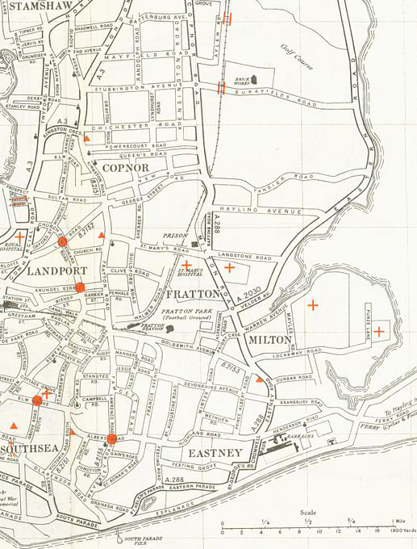
BIBFLOW: A Roadmap for Success
Thank you!

